Slide 1
IBM University Engagement Project Submission

Slide 2

Project Title – [AI-powered Writing assistant agent (Inkwell)]
Domain of Project – [ Productivity, Literature, Education]
Student Name | Recent Passport Photo | Email ID | Mobile number [WhatsApp]
Hamsadhwani A S |  | hamsadhwanias@gmail.com | 6379412724

Slide 3
Problem Statement -
Problem Statement : Writing assistant agent
The Challenge
Writing, regardless of whether it is academic or creative, requires lots of research, review and edition. Often times , writers use multiple resources for different steps of the writing process, which can be exhausting, time consuming and cluttered. This agent aims to help writers focus on the writing part more by bringing together multiple resources at the same space.
The objective
Build an AI-powered Writing assistant agent that offers a variety of tools and chat assistance for writers:
Answering questions related to writing. Provide alternative words for a given word. Provides a word for a given description. Provides the meaning, usage and pronunciation of words. Has a writing space which allows users to write a draft and download as a word file. Checks and fixes grammar in the draft. Provides multiple features in a single space so users do not have to hop between tabs. Will not write for the users , but will help the users write by providing tools instead.

Slide 4
Proposed Solution
The proposed solution is an AI-powered Writing Assistant built using Streamlit and IBM watsonx.ai with the Llama 3.3 70B Instruct model. It helps users improve their writing by checking grammar, improving vocabulary, and answering writing-related questions through an easy-to-use interface.
The system consists of four main modules:
Grammar Assistant checks grammar, spelling, and punctuation mistakes, explains the errors, and provides corrected text.
Vocabulary Assistant gives word meanings, pronunciations, synonyms, example sentences, and word origins to improve vocabulary.
Writing Guidance Assistant answers questions about grammar, sentence structure, writing techniques, and language usage through an AI chat interface.
Document drafting feature allows users to write, edit, and download their work as a professionally formatted Word document.
The application provides a simple Streamlit dashboard where users can write their content, check grammar, learn new words, ask writing-related questions, and save their documents.
IBM watsonx.ai is used to run the AI model, while the Llama 3.3 70B Instruct model handles grammar correction, question answering, vocabulary assistance, and writing support.
Overall, the solution provides an intelligent writing assistant that helps users write more accurately, improve their vocabulary, and create better-quality documents with real-time AI assistance.

Slide 5
Technology Used
llama-3-3-70b-instruct - for natural language understanding, reasoning, and personalization
IBM Cloud – It provides the infrastructure to build, deploy, and scale the Nutrition Agent efficiently. IBM Cloud enables a reliable, secure, and scalable environment for deploying the Nutrition Agent.
RAG– RAG to fetch real data first, then generate intelligent answers, making the Nutrition Agent more trustworthy and effective.
IBM Watsonx.ai Studio - For model deployment, embeddings, and AI governance
Watsonx.ai Runtime – For machine learning and operation of agent.
IBM Bob – To build the agentic AI web application and give interface with streamlit

Slide 6
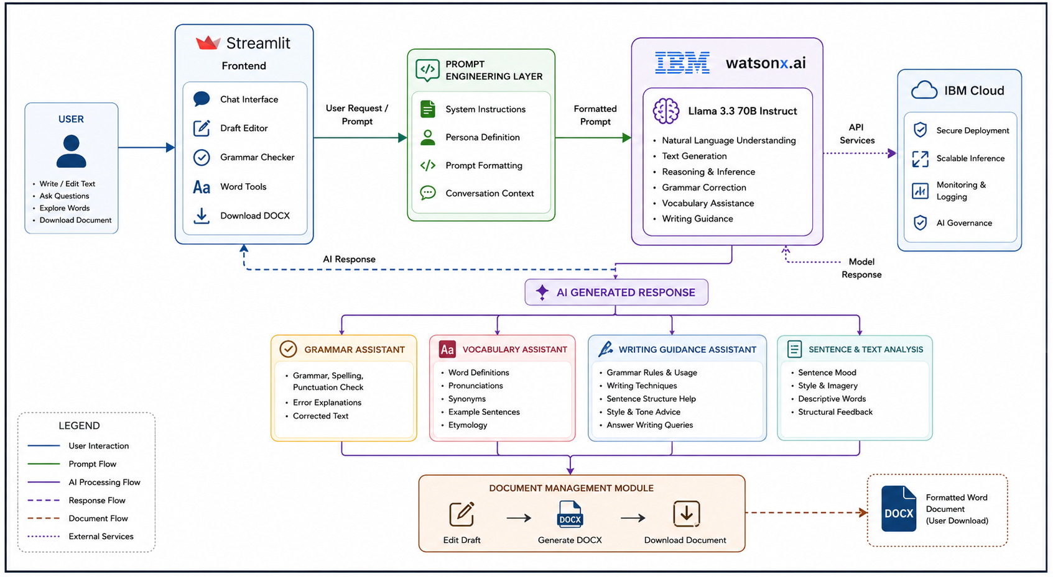
Architecture blueprint

Slide 7

Role of Agentic AI in the solution
Agentic AI enables the AI Writing Assistant to provide intelligent and interactive writing support instead of just basic text correction. Using IBM watsonx.ai and the Llama 3.3 70B Instruct model, it understands user requests and responds accordingly.
It helps users by checking grammar, explaining mistakes, answering writing-related questions, providing word meanings and synonyms, and suggesting improvements based on the context of the text.
The AI also remembers the conversation during a session, allowing it to give more relevant and personalized responses.
Overall, Agentic AI makes the writing assistant smart, interactive, and easy to use, helping users write more accurately and confidently.

Slide 8
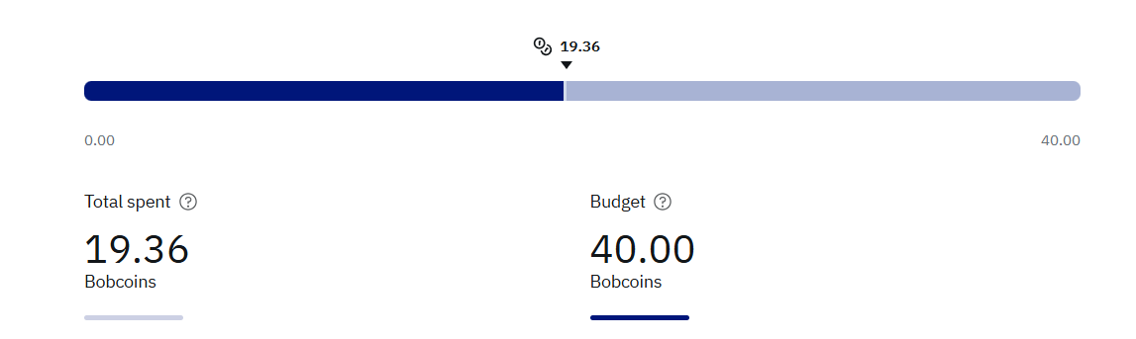
Token Usage
·
·
·

Slide 9
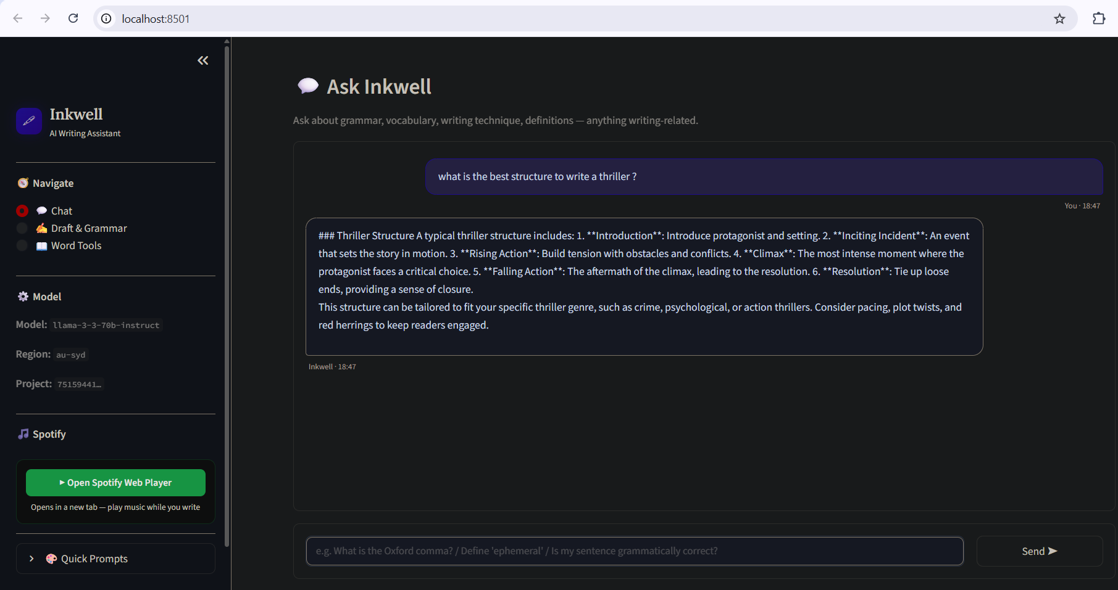
Agent screenshots

Slide 10
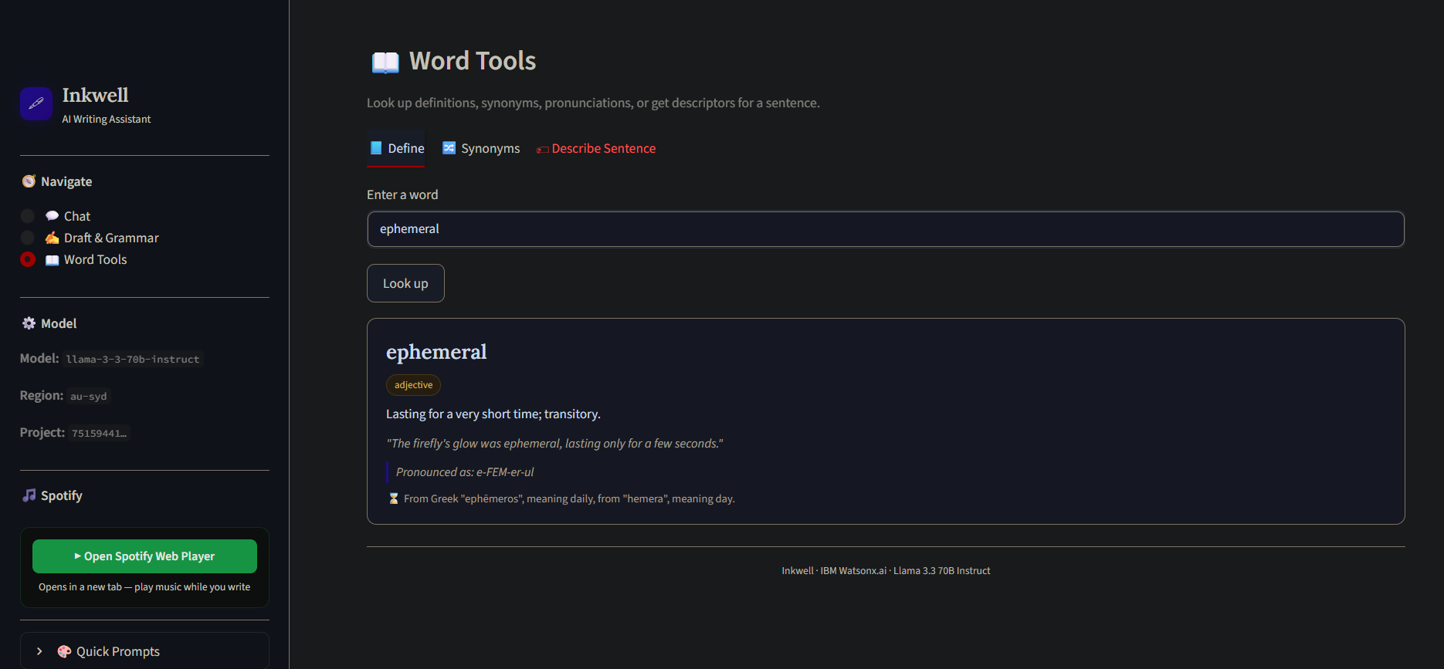
Agent screenshots

Slide 11
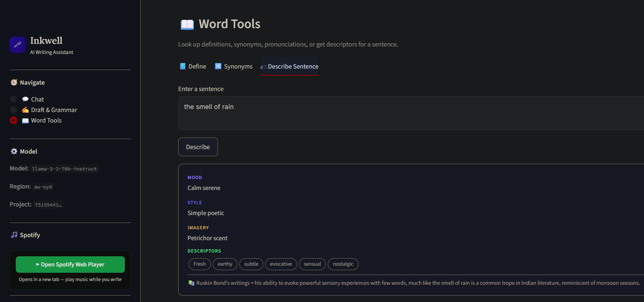
Agent screenshots

Slide 12
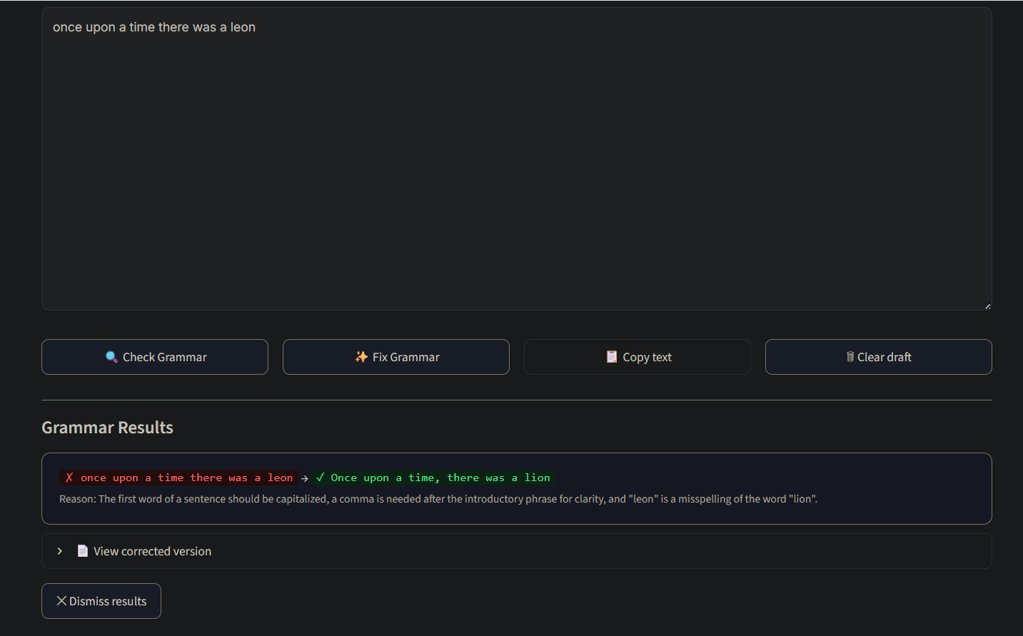
Agent screenshots

Slide 13
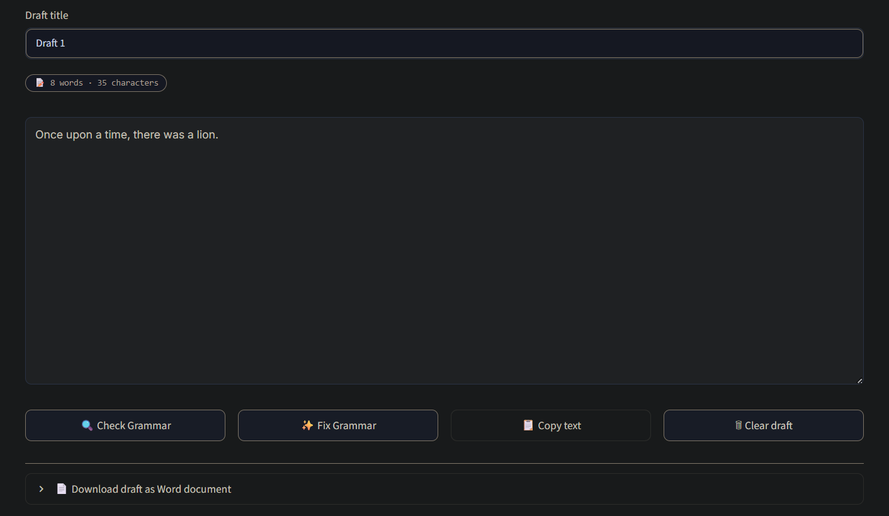
Agent screenshots

Slide 14
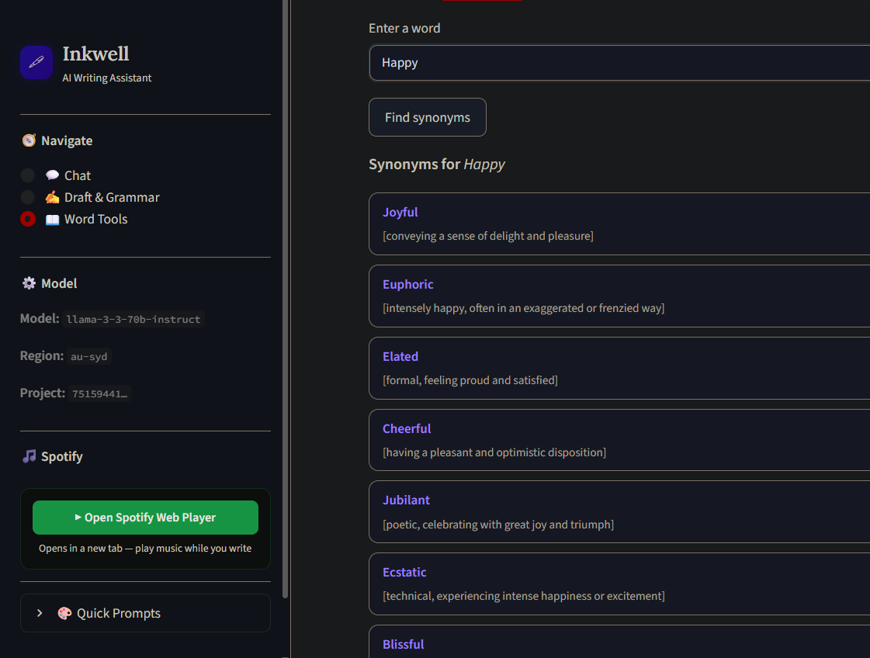
Agent screenshots

Slide 15
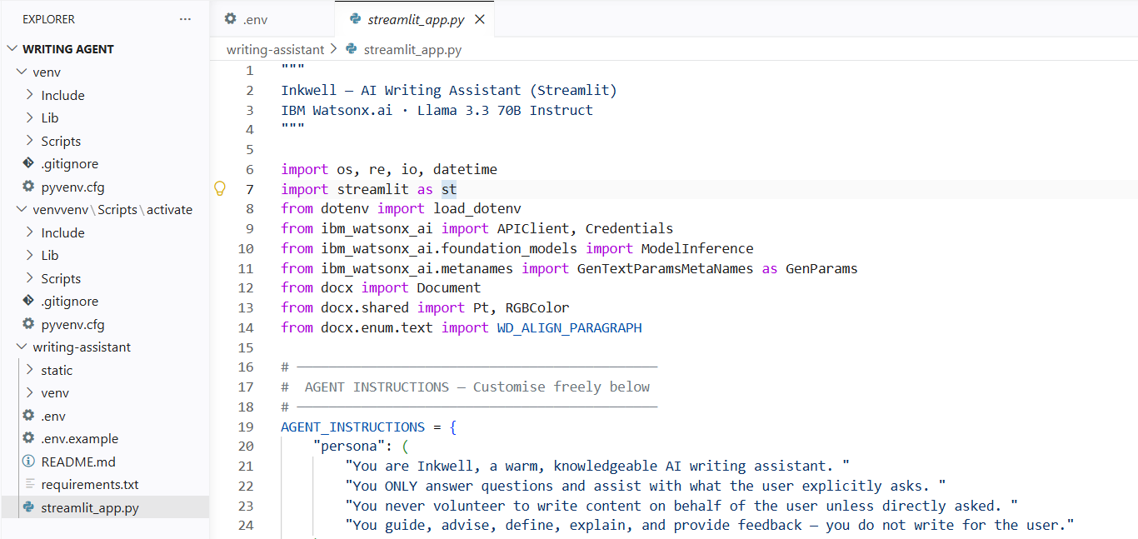
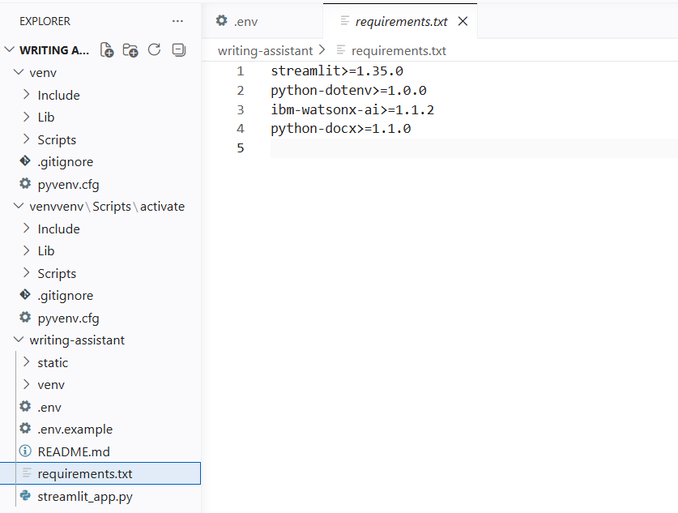

Slide 16
Novelty and Uniqueness
The proposed AI Writing Assistant stands out by combining intelligent writing support, vocabulary assistance, and document management into a single easy-to-use application.
All-in-One Writing Tool – Combines grammar checking, vocabulary assistance, writing guidance, and document export in one platform.
Context-Aware Responses – Understands the user's input and provides relevant corrections and suggestions instead of simple rule-based feedback.
Interactive AI Chat – Allows users to ask writing-related questions and receive instant explanations and guidance.
Vocabulary Enhancement – Provides definitions, synonyms, pronunciations, example sentences, and word origins to improve language skills.
Easy Document Management – Enables users to write, edit, correct, and download their work as a professionally formatted Word document.
Powered by IBM watsonx.ai – Uses the Llama 3.3 70B Instruct model to deliver accurate and reliable writing assistance.
This makes the solution an intelligent writing companion, helping users improve their writing skills instead of simply correcting mistakes.

Slide 17
Git Hub Link
Github URL: https://github.com/has2k24/writing_assistant_agent
·
·
·

Slide 18
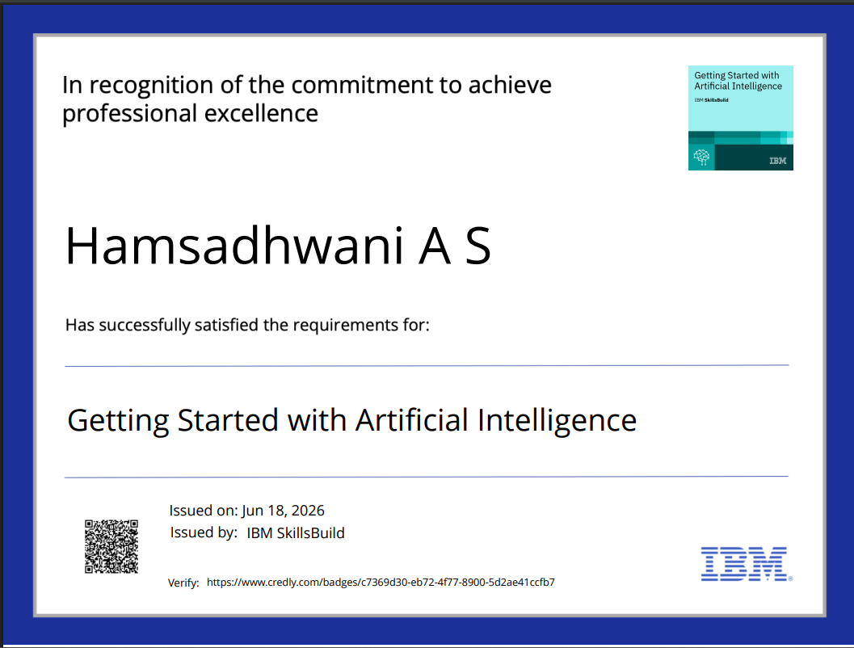
Certificates Earned:
Please add your credly certificate

Slide 19
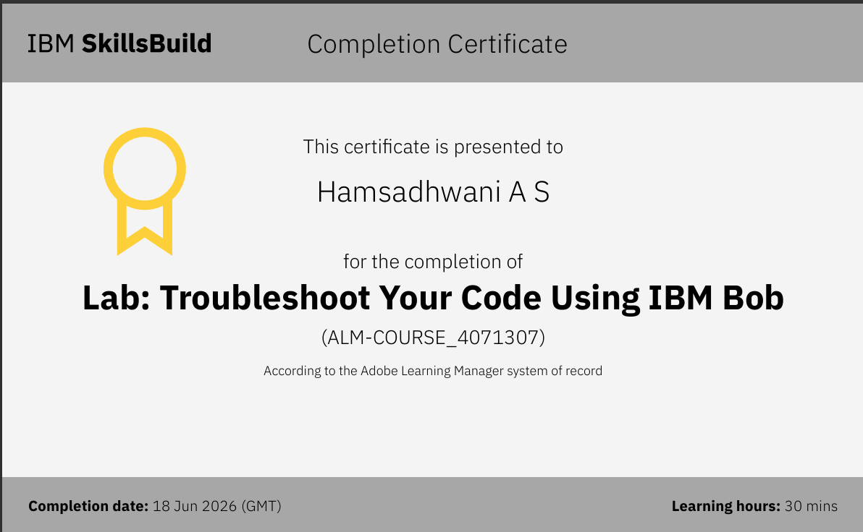
Certificates Earned:​
Add your IBM BOB Certificate

Slide 20


